Slide 1
“Education makes people easy to learn
but difficult to drive;
easy to govern
but impossible to enslave.”
Lord Brougham
LULU S. MOGUEL
(MKTG. & HRD)
CONSULTANTS, INC

Slide 2
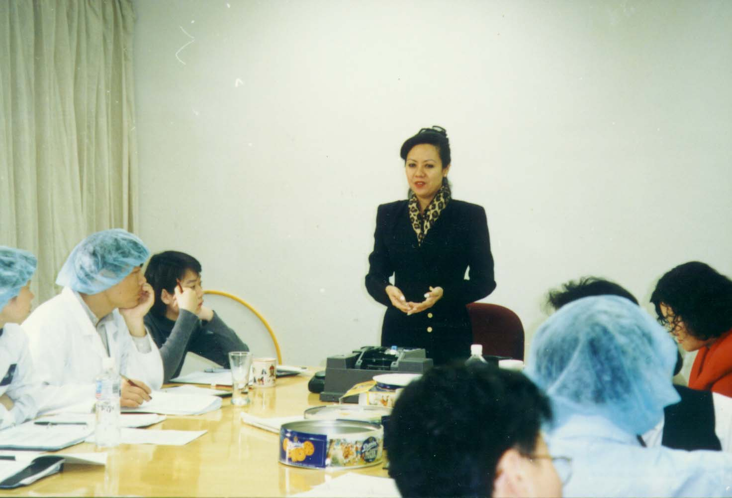
SO YOU MAY KNOW ABOUT US

Slide 3
We, at LSMCI, believe that
we are a segment of the country’s
educational system in the pursuit
of developing each individual’s potentials
and abilities, making each realize and
recognize the human dignity
(the very basis of human relations)
he deserves as a creature made in
the image of God.
We believe in the unwavering involvement
of our management to the personal
development of our people to promote
the highest order of motivation
and competency level.
We believe in delivering the highest
standard of service (regardless of
time, period, and place) in a manner that is
socially responsible and that which commands
respect for integrity, through our competent
and dedicated personnel so we may
fulfil our commitments to our partners
and stockholders.
We trust in the Divine Guidance
of the Almighty God.
MISSION STATEMENT

Slide 4
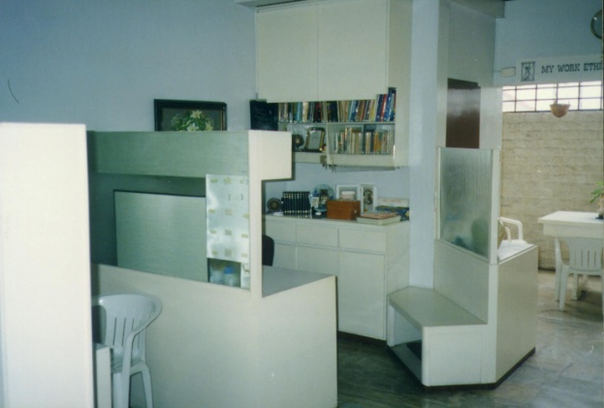
Founded in 1989
Initially seated at PSSC
Moved to U-25 Parian Commercial Complex until 1999
Currently at U-2907 Pioneer Highlands Condominium,
Pioneer St, Mandaluyong
Web Site: www.skybiz.lulumoguel
E-mail Addresses: moguelle@info.com.ph
lumoguel@mozcom.com

Slide 5
People Behind:
Lulu S. Moguel
Fr. Luis Candelaria, S. J.
Rainier M. Carrasco
Ryan M. Carrasco
Dr. Leticia Tumambing

Slide 6
Services:
Personality Assessment
Recruitment
Training
Training Needs Analysis
Organizational Health Survey
Management Audit
Job Evaluation
Performance Appraisal Systems
Surveys
Curriculum Designing
Digitizing –transferring analogue to digital output
“Hi tech, high touch.”

Slide 7
“Be more, so you can achieve more.
Learn more, so you can serve more.”
Jesuit Magis
Partners:
Ateneo Center for Continuing Studies
Ateneo Institute of Banking
Ateneo Information Technology Institute
De la Salle Professional Schools Center
Topper Human Resources Consultants, Ltd. (China)
Taft Consulting Group
Association of Pharmaceutical Trainers

Slide 8
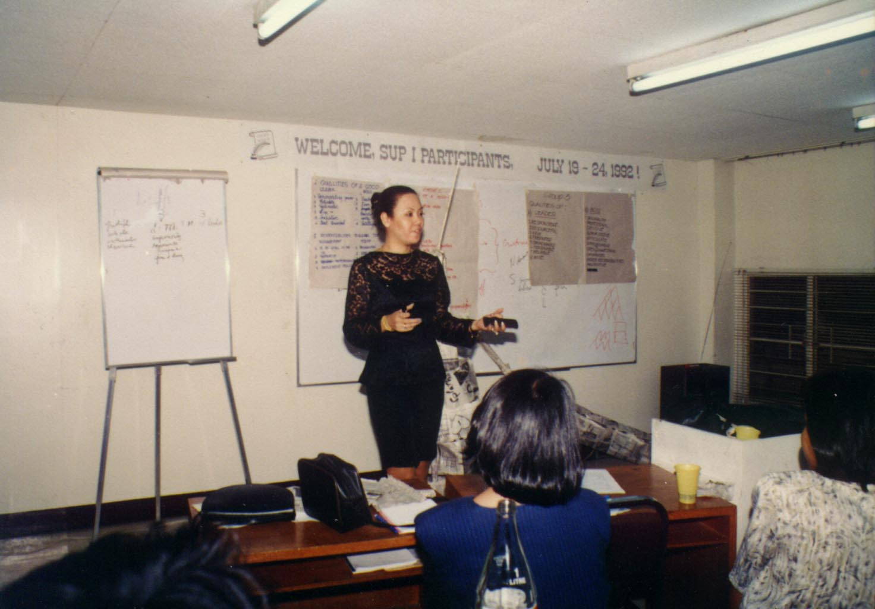
Training Programs:
Personal Effectiveness Program
Corporate Values Development Program
Team Dynamics
Leadership 2001
Customer Intimacy
Sales and Marketing
Time Management
Effective Business Communication
Strategic Management
Project Management
Performance Appraisal
Coaching and Counseling
The Professional Secretary
Training the Trainers
Training Needs Analysis
Spiritual Formation in Management
Human Resource Systems
Corporate Planning
Presentation Skills

Slide 9
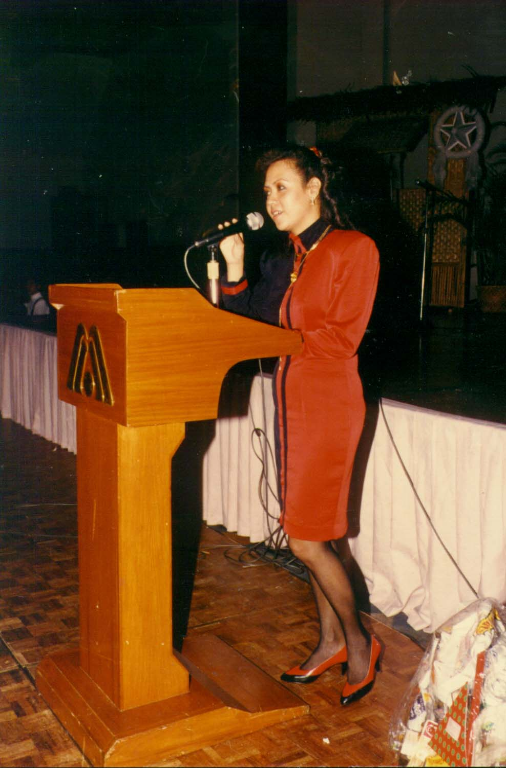
CURRICULUM VITAE
Ma. Luisa “Lulu” S. Moguel

Slide 10
Maria Luisa (Lulu) S. Moguel
Ms. Moguel is a management consultant and an organizational
development specialist. Her field of expertise is in Human
Resource Development encompassing the design and conduct
of training programs in the areas of management, supervision,
customer relations, marketing and sales, personality development,
training the trainers, secretarial development, team building, planned change and value formation among others. At present, she oversees her own operations at the LSM (MKTG. & HRD) Consultants, Inc. and training for local and multi-national establishments in the country and abroad. She has been invited to assist in developing small-scale industries and guide them in running their own business set-up. She is one of the pioneer resource speakers of Ateneo de Manila University's Institute of Banking and Center for Continuing Education. She also extends her services to the campuses of: Ateneo de Manila University (Loyola Heights) undertaking leadership seminars for the students, De La Salle University engaging in diversified programs for St. Benilde College students, and Asian Institute of Tourism as sole resource person for Personality Development in their annual Practicum Seminar for graduating students since 1983. She was formerly connected with John Clements Consultants, Inc. as Senior Management Consultant.

Slide 11
Business Experience:
Chief Executive Officer, Lulu S. Moguel Marketing &
HRD Consultants, Inc. (1989 - Present)
Senior Consultant, Fundamentals (2000 – Present)
Training Specialist, Coordinating Council for Private
Sector Participation (Office of the President) for
Build-Operate-Transfer Programs (1999-Present)
Faculty, Ateneo Information Technology Institute, (1998 – Present)
Senior Resource Speaker and Program Director for Human Dynamics,
Ateneo de Manila University-Banking Association of the Philippines
and Center for Continuing Education (1993 - Present)
President and General Manager, Management Assistance Service, Inc.
(1981 - 1985)
Consultant, Development Academy of the Philippines (1983)
Coordinator, Human Resource Center - Ateneo de Manila University
(1981 - 1983)
Remittance Supervisor, Philippine National Bank - Hongkong (1980)
Secretary to the President, Filipinas Cement Corporation (1980)
Instructor, Canadian Academy, Kobe, Japan (1972)
Student Teacher, Stella Maris International School, Kobe, Japan
(1970 - 1971)

Slide 12
Surveys:
Training Needs Analysis, CCPSP (2000)
Training Needs Analysis, Wrigley Phils. (1999)
Training Needs Analysis, Eastern Telecom (1998)
Training Needs Analysis, Permaplans (1997)
Mystery Client Survey, Philippines Seven
Corporation (1992)
Training Needs Analysis/OD Survey - Toyota Motor Philippines
(1990)
Training Needs Analysis /OD Survey - JS Gaisano (Davao) (1995)
Training Needs Analysis/Career Pathing - DCCD Engineering
Corporation (1996)
Organizational Development Survey - Duvaz Corporation (1996)
Social Pulse and Political Surveys/ Think Tank:
Mayoralty, Pasay City, 1987
Feasibility Study, Jer Latex (Phils) Inc., 1989
Congressional, 1st District, Batangas, 1987 & 1992
Senatorial, Metro Manila 1992
Mystery Shopper for 7-11, 1992

Slide 13
Other Projects:
Cagayan Valley Integrated Development Plan (1983)
Job Evaluation, Philippine International Exporters (1986)
World Bank Premiumed Projects, Department
of Local Government (1990)
Training for Decentralization Program and Marketing
Strategies, Pag-Ibig Fund (1990)
Pre-launching Activities, Scandinavian Motors for "VOLVO" (1994)
Training of all new recruits for the new Grand Boulevard Hotel (1994)
Personality Development Seminar for new graduates of Asian Institute of Tourism (1984 - Present)
Conduct and Constant Monitoring of Customer Service Workshop, BPI Family Bank Branches, Metro Manila (1990 - Present)
Teambuilding for Plant and Office Personnel, Toyota Motor Philippines Corporation (1990 - 1994)
Work Ethics, Philippine Veterans Bank - All Personnel (1993)
Management Tools and Techniques, Basic Management Courses
Branch Managers/ Supervisors, Security Bank and Trust Co. (1993)
Training of Projects Personnel, Miss Universe Pageant (1994)
Supervisory Development Program for Officers Training, Landbank of the Philippines (1994 - Present)
Customer Relations / Teambuilding for Personnel, Supervisors, Managers for Pilipinas Bank / Leadership - Bankwide (1994 - 1997)

Slide 14
Service Edge Program Implementation, Unilab (1995 - Present)
Development of Customer Relations Model, Banco Filipino (1995)
Continuous Development of Trainers, Consolidated
Maritime Resources Foundation, Inc. (1994 - Present)
Implementation of VTP/ Word Bank Projects for TESDA,
former NMYC (1983 - Present)
Personality Development for Frontliners, RCPI Bayantel-Nationwide (1996)
Personality Development and Leadership Programs for Pilipinas Bank, Bankwide (1996)
Secretarial Development Program, PCIBank Academy (1996)
Sales Management, Toyota Brunei (1996)
Working With Filipinos/Expat Program, Sunward Technologies, Inc. (1997)
Planning for Opportunities/Retiree's Program, PLDT -Nationwide (1997)
Work Ethics/Teambuilding Program, Hard Rock Cafe (1997)
Customer Handling Program, Toyota Cubao, Inc. (1996-Present)
Training Needs Analysis, Eastern Telecommunications Phils., Inc. 1997-1998
Corporate Values Program, DCCD Engineering Corp. All Personnel (1997-1998)
Corporate Values Program, Dunlop Slazenger (Phils.) Inc. –All Personnel (1999)
Coaching and Counseling for Peak Performance, Security Bank, Bankwide -
Vice Presidents and Branch Managers (October 1997-1998)

Slide 15
Leadership 2000, DCCD Engineering Corp. –Supervisors
and Managers ( May 1998 –2000)
Setting up Training Activities for Dunlop Slazenger (Phils.) Inc.
(May 1998 - 1999)
Teambuilding, Customer Service Programs, All Asia
Capital & Trust Corp. (May 1998)
Corporate Values Program, Dunlop September – October, 2000)
Leadership, Stores Specialists, Managers and Supervisors, (March-April, 2001)
Dunlop Slazenger (Phils.) Inc. (April-September, 1999)
Corporate Values Program, Mega Paint and Coating Corp. All Personnel,
(July-August, 1999)
Corporate Values Program, Luzon Development Bank , Bankwide (November, 1999
- January, 2000)
Team Dynamics in the New Millenium for all the Managers, Eastway Travelgoods, Inc.
(February, 1999 and February,2000)
Sales and Marketing in the New Renaissance, Rustan Marketing Corporation,
Managers (July-September, 2000)
Customer Intimacy, Rustan Marketing Corporation, Managers (September-
October, 2001 )
Personality Development, Rustan Marketing Corporation, Beauty Consultants
(September-October, 2001)
Projecting the Professional Image, Rustan Marketing Corporation, Managers,
(September-October, 2001)

Slide 16

Training Programs Attended:
How to Make Your Team Unstoppable, Covey Leadership Center
Transactional Analysis, John Dowling
Bioenergetics, Dolly Perez
Cagayan Valley Integrated Development Plan, Development
Academy of the Philippines
Organizational Dynamics, John Clements Consultants
ASTD International Conference & Exposition (May 31-June 04,1998)
in San Francisco
Conference of E-Business in the Philippines, March 16, 2001, Ateneo Information
Technology Institute
Values and Directions for Ignatian Leadership, September 20-223, 2001
Ateneo de Manila University
Berlitz, January 21-25, 2002, Berlitz Philippines
Membership:
American Management Association
American Society for Training and Development
Horizon Condominium Homeowners Association, Director
Rotary Club of Manila Bay
Our Lady of Rosary Makers, Kentucky, USA

Slide 17
Educational Background:
MBA, Ateneo Graduate School of Business
Ateneo Regis Program
(Gold Medalist)
MA, Industrial/Organizational Psychology
Ateneo de Manila University
AB International Studies Major in Systems & Organizations
Maryknoll Colleg
High School , International School, Kobe Japan

Slide 18
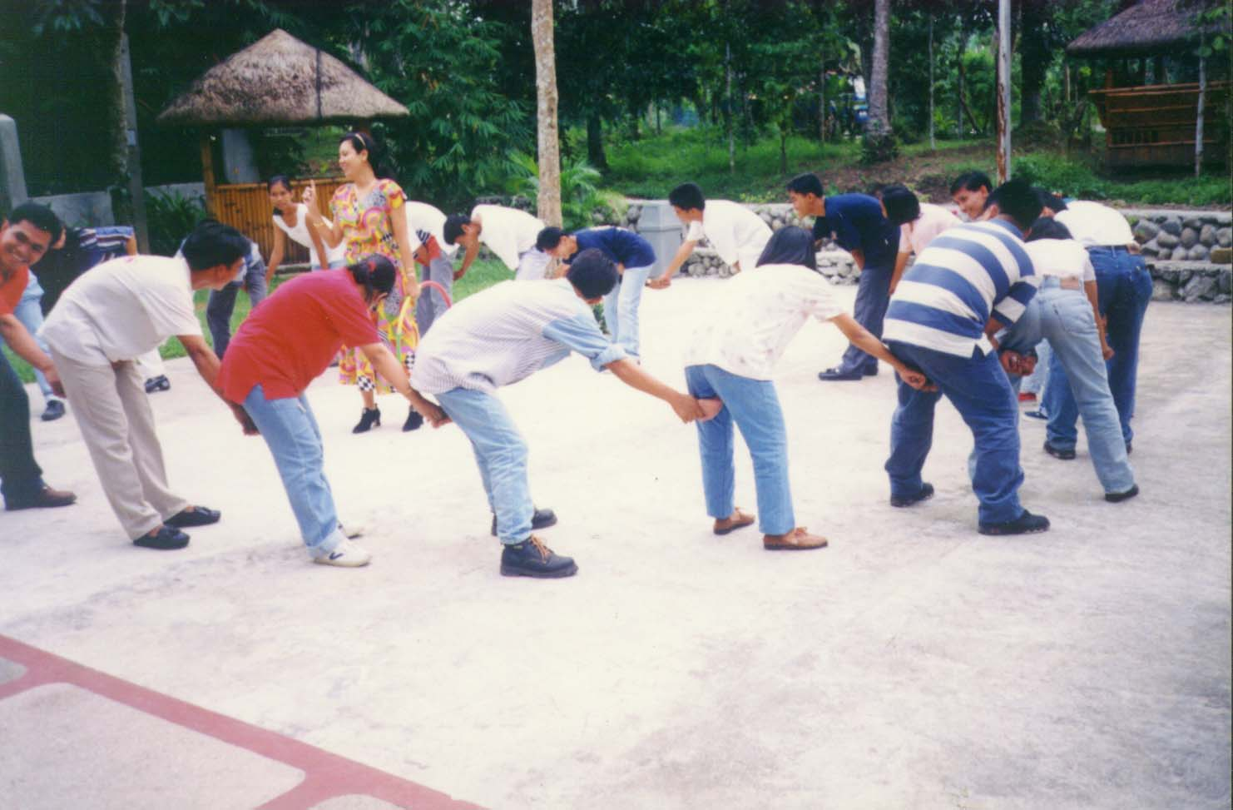
CLIENTS SERVED:

Slide 19



Clients for Digitizing:
Kodak
Shell

Slide 20
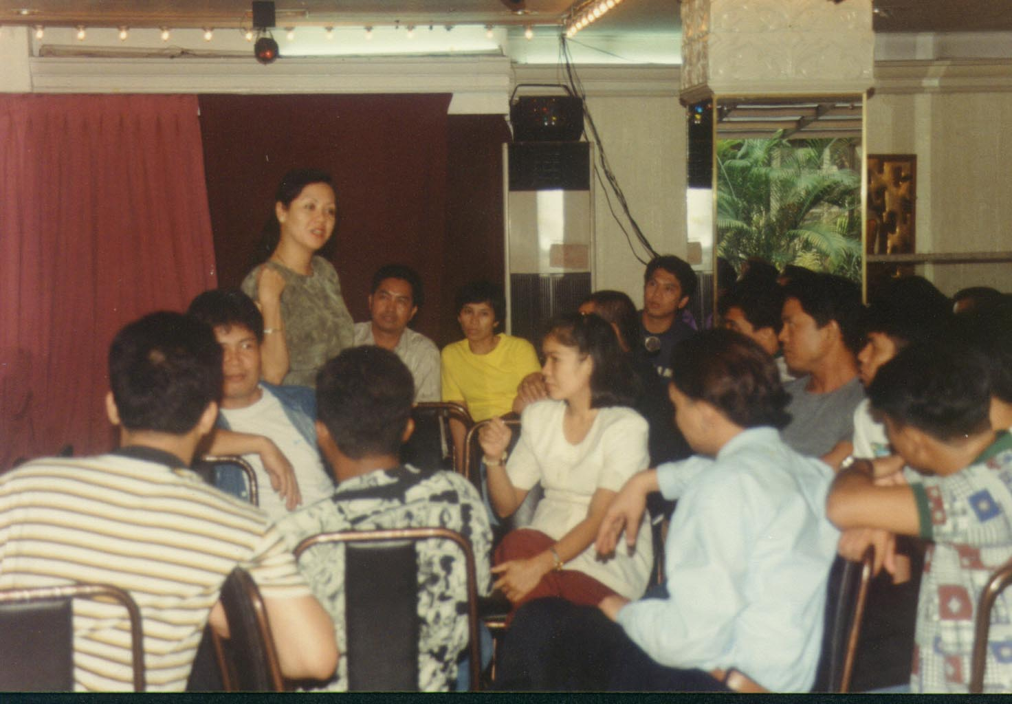
Clients for Training
(With or Without OD)

Slide 21
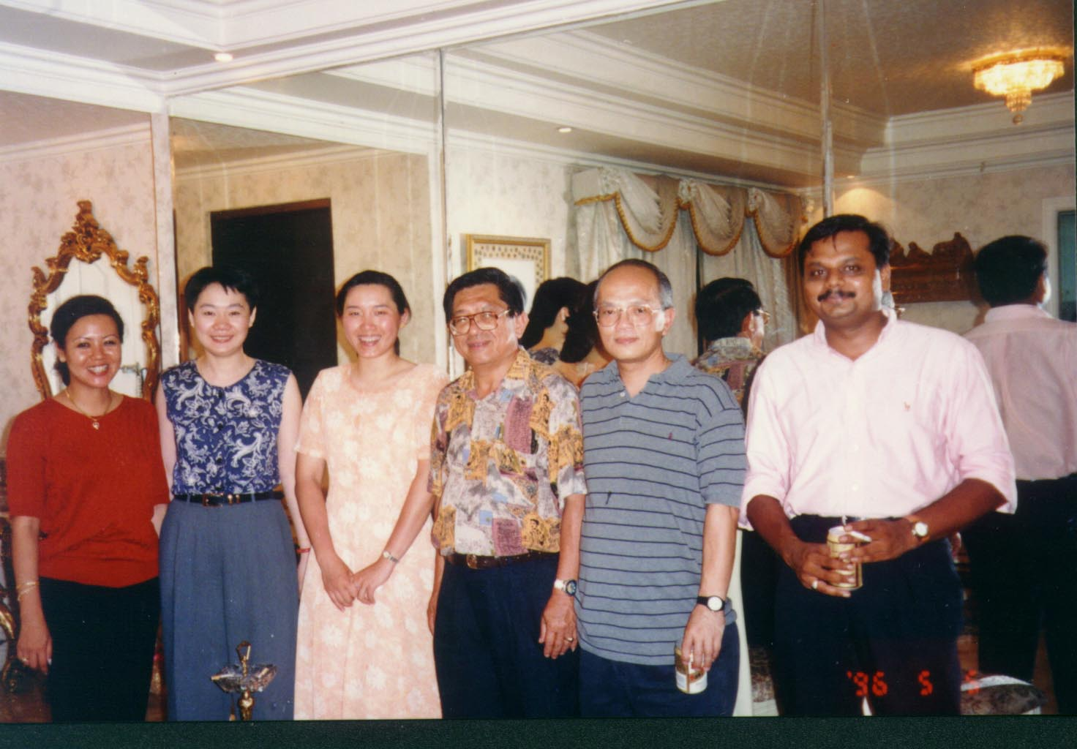
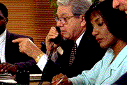
International Clients
Sperry Univac (Singapore)
Toyota NBT (Brunei) SDN BHD
Wrigley Chewing Gum Co., Ltd. (China)

Slide 22

Manufacturing
ACI Fiberglass Phils., Inc.
Arms Corporation
Capital Garments Corp.
Commonwealth Foods, Inc.
Concrete Aggregates Inc.
Dunlop Slazenger (Phils.) Inc.
Dynacraft, Inc.
Fashione Fabrics, Inc.
First Asia Ventures Capital Inc.
Freysinnet Phil., Inc.
Fuller O'Brien Paint Co., Inc.
Greenfield B
Harman Manufacturing Inc.
Imarflex Battery Manufacturing Corp.
International Flavors and Fragrances
Johnson & Johnson (Phils.) Inc.
Judy Philippines, Inc.
Kohzan Cavite, Inc.
L & T International Group (Phils.) Inc.
Liberty Commodities Corp.
Mariveles Apparels Corp.
Mattel Phils., Corp.
Mega Paint & Coating Corp.
Multipure Phils. Corp.
PAMCOR (Mitsubishi) Inc.
Philippine Integrated Exporters, Inc.
Philippine Resins Industries Inc.
Philips Industrial Development, Inc.
Plastimer Industrial Corporation
Polyseal Manufacturing Industries Inc.
Republic Glass Corp.
San Miguel Corp.
San Miguel Group of Companies
Sampo Technology (Phils.) Inc.
SC Johnson & Son, Inc.
SEA Commercial Corporation
Semexco Marketing Inc.
Sime Darby Philippines Inc.
Solmac Marketing Inc.
Southern Energy Philippines
Texfiber, Inc.
Toyota Motor Phils., Inc.
Trebel
Univille Motors Corp.
Warner Lambert Corp.
Worldwide Paper Mills, Inc.
YKL Laboratories

Slide 23
Banking
Bank of the Philippine Islands
BPI Family Bank
Far East Bank and Trust Company
Asian Development Bank
Bank of Commerce
China Banking Corp.
Philippine Veterans Bank
Interbank
Rizal Commercial & Banking Corporation
Security Bank and Trust Company
Pilipinas Bank
Banco Filipino
PCI Bank Academy
Development Bank of the Philippines
Luzon Development Bank

Slide 24
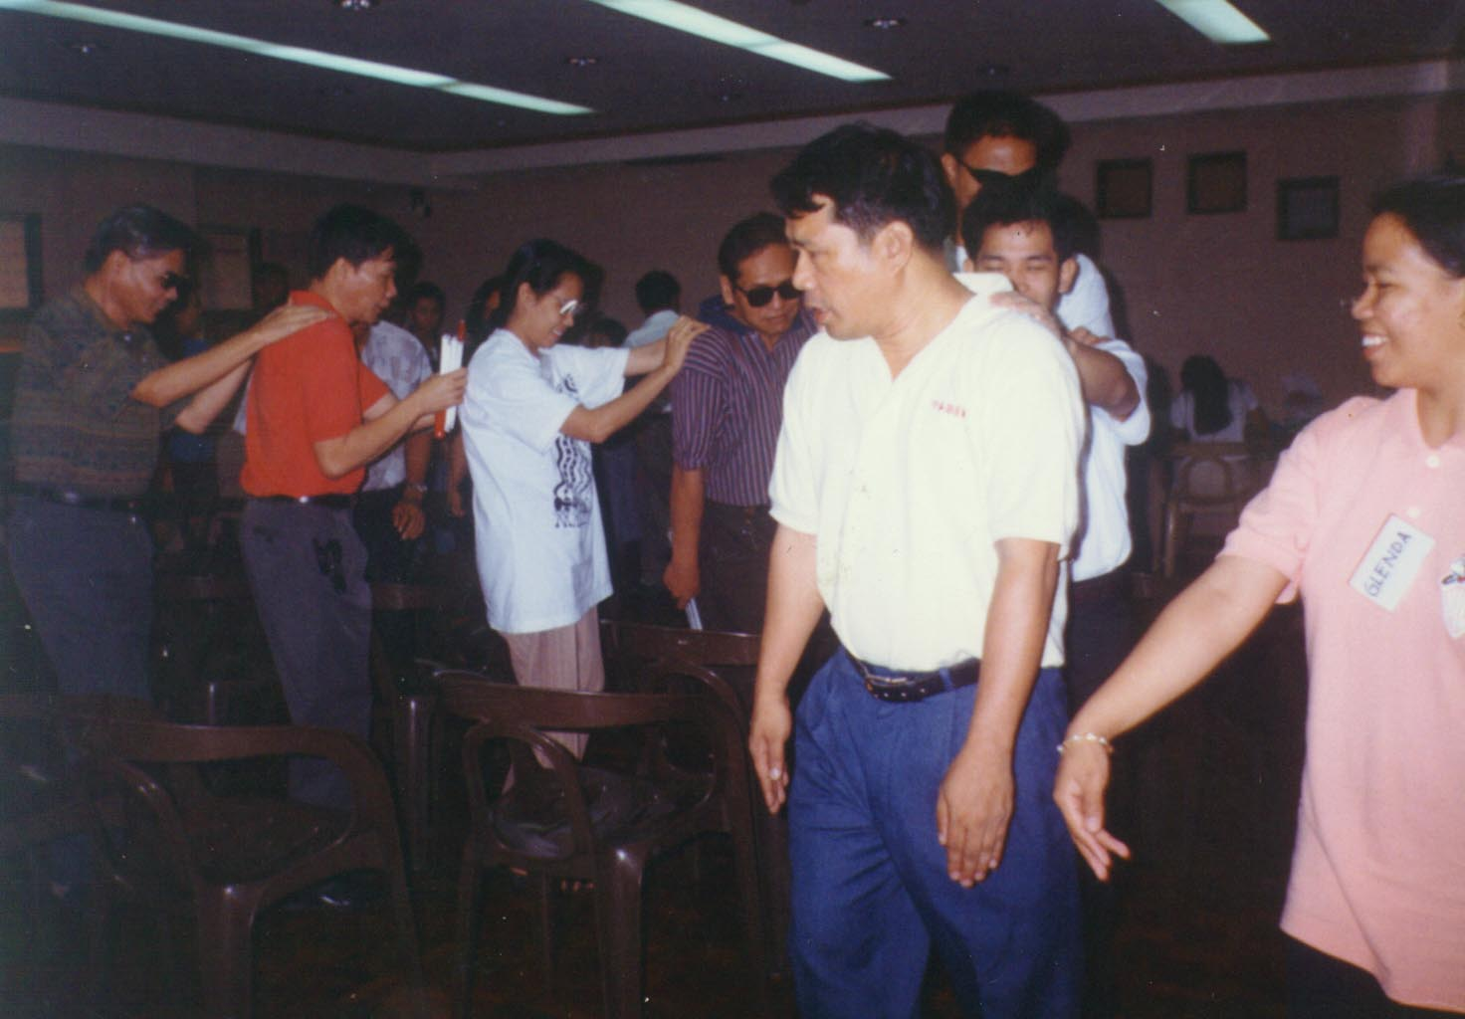

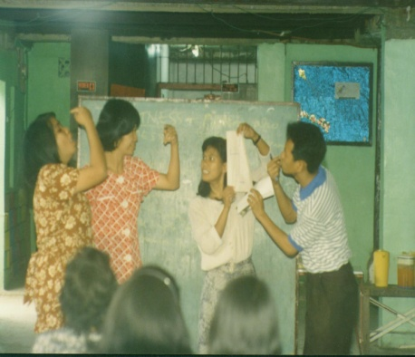

Religious / Community Groups
Philippine Episcopal Church
Cagayan Valley Integrated Agricultural Development Plan
Cooperatives for Farmers - Bicol Region
Samahang Bayanihan - Pasay City
Political Machinery for Mayor Calixto
Congressional Machinery for BC Movement - Batangas
Foundation for Professional Training Inc. (Opus Dei)
Visually Impaired Brotherhood for Excellent Services, Inc.
Knights of Columbus Fraternal Association of the
Philippines, Inc.

Slide 25



Semi-Conductors
Fenics Corporation
Fastech Micro Assembly and Test Inc.
Ionics Corporation
Sunward Technologies Phils., Inc.
Japan Aviation electronics
Computers
IBM
NCR
Sperry Univac, Inc. (AsiA) Uniphil Computer Corp.

Slide 26



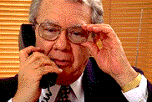
Utilities/ Telecommunications
RCPI-Bayantel
ICC Telecoms
Globe-Mackay Cable and Radio Corp. - ITT
Meralco
Ogden Philippines Operating Inc.
Philippine Long Distance Telephone Corp.
Eastern Telecommunications Philippines Inc.
Starpager 2000
Telserv (Piltel/Beeper 150)
AVT Inc.

Slide 27


Hotels/Restaurants/Food Chains
Grand Hotels and Resorts Group
Asian Institute of Tourism House
Davao Insular Hotel
Jollibee Foods Corp.
Mandarin Hotel
Max's Restaurants
Mix Plant, Inc.
Hotel Danarra and Resorts
Sulo Hotel
Red Ribbon Bakeshop
Hard Rock Cafe
Pharmaceutical
United Laboratories, Inc. Elan Laboratories
MetroPharma Pascual Laboratories
Alcon Laboratories
Diamond Laboratories, Inc.
Med-Asia Inc.
Spade Pharmaceuticals, Inc.
Metro Drug Distribution Inc.
Diethelm Philippines Inc.
Novartis
Hospitals
St. Luke's Medical Center
Manila Central University

Slide 28

Advertising
AMA-DDB Needham Worldwide Inc.
Law Office
Quasha, Ancheta, Peña, Nolasco Law Office
Consultancy
John Clements Consultants, Inc. - HRODD
John Clements Consultant, Inc.
Staffbuilders International
Insurance
All Asia Capital & Trust Corp.
CCC Insurance
Delgado Brothers, Inc.
Loyola Plans, Inc.
Loyola Education Systems, Inc.
Malayan Group of Companies
Permanent Plans, Inc.
Cocoplans

Slide 29

Non-Government Organization
United Nations Children's Fund
Peace Corps
Unang Lingap Kapwa
Tourism Industry Board Foundation Inc.
Printing Industry Board Foundation Inc.
Construction Manpower Development Foundation
Quezon City Chamber of Commerce & Industry Inc.
Greater Valenzuela Chamber of Commerce & Industry Inc.
FTI - Taguig Chamber of Commerce & Industry Inc.

Slide 30

Government Agencies
Bureau of Land and Transportation
Bureau of Posts
Bureau of Internal Revenue
National Development Corporation
Pag-ibig Fund
National Manpower and Youth Council / TESDA
Philippine Convention & Visitors Corporation
Philippine International Convention Center
Philippine Postal Corporation
Philippine Overseas Employment Agency
Department of Health - Bureau of Licensing and Registration
Philippine National Red Cross
CCPSP – Office of the President
ODAPP –Office of the President
Philippine Senate Secretariat
Bangko Sentral ng Pilipinas

Slide 31

Schools
Air Force Officer's School
Consolidated Maritime Resources Foundation Inc.
Asian Institute of Tourism
Ateneo de Manila University
De La Salle University
Olivares Institute
IBM Learning School
Asian Institute of Electronics
Manila Central University
Sunny Hill School
Emmaus Christian School
Bible Institute for the Deaf
Eduquest
Poveda

Slide 32


Shipping/Forwarders
Circle Freight International (Phils.) Ltd., Inc.
Crestamonte Shipping
Delgado Brothers and Terminal, Inc.
Four Winds
Gasti, Inc.
Sky Freight Forwarders Inc.
Freight Group Asia, Inc.
Aboitiz Inland Carriers Ins.
FLT Customs Brokerage Inc.
Travel Agencies
Jalink Inc.
Delgado Brothers, Inc.

Slide 33

Realty
Real Estate Brokers Association of the Phils. (REBAP)
Fil-Estate Network Inc.
Jardine Properties, Inc.
Master Inc./Britanny
V.V. Soliven
Orchard Property Management Corporation
ASB Realty
Electrical Appliances Distributor
Trademark Industries, Inc.
Victron Sales Corporation
Car Dealership
Toyota Cubao Inc.
DMG Motors, Inc.
Stores
Rustans Commercial Corp.
Syvel's
Philippine Seven Corporation
Holland Blooms
Stores Specialists Inc.
Gaizano (Davao)

Slide 34

Lumbering
M & S Lumbering Corp.
Provident Tree Farms
Sirawai Plywood and Lumber Corp.
Timber Industries of the Philippines, Inc.
Construction
Jardine James Hardie Phils. Co. Inc.
Construction Services of Australia-Phils., Inc.
DCCD Engineering Corp.
Phesco, Inc.
William Golangco Construction Corp.
Moldex Products, Inc.
Moldex Group of Companies
Moldex Realty Inc.
Permanent Homes, Inc.

Slide 35


Mining
Benguet Corp.
Itogon - Suyoc Mines, Inc.
Printing
Maryland Publishing
Orient Integrated Commercial Inc.
OMF Literature
Rex Publishing Corp.
Business World Inc.
Bookman Inc.

Slide 36
List of Companies
which availed of the
Training the Trainers Program
UNDER TESDA –WORLD BANK SUBSIDY:
Tourism Industry Board
Philippine Printing Industry Board Foundation, Inc.
Foundation for Professional Training (Opus Dei)
Danarra Hotel
Vacation Hotel
Sulo Hotel
Fenics Corporation
Moldex Group of Companies
Grand Hotel and Resort Group
Ionics Corporation
Fortune Tobacco Corporation
Marikina Valley Chamber of Commerce
Greater Valenzuela Chamber of Commerce and Industry Inc.
Emmaus Christian School
Bible Institute for the Deaf
Manila Galleria Suites
Rustan Commercial Corp.
Visually Impaired Brotherhood for Excellent Services (VIBES)

Slide 37
List of Companies
which availed of the
Training the Trainers Program
LSMCI Direct Clients (Not Under Subsidy)
Wrigley Chewing Gum Co., Ltd. (China)
Wrigley Chewing Gum Co., Ltd. (Taiwan)
Philippine Seven Corporation
Air Force Officers School
Consolidated Maritime Resources (Yearly)
Toyota Motor Philippines Inc.
Eastern Telecommunication (Philippines) Inc.
Southern Energy Philippines (All Trainers)
Bureau of Internal Revenue (All Trainers-Nationwide)
Philippine Postal Corporation (All Trainers-Nationwide)
Ogden Philippines Operating Inc.
YKL Development and Trading Corp.
CCPSP-Office of the Philippines

Slide 38
Team Dynamics Program
(Corporate Accounts)
Toyota Motor Philippines Corporation (Plantwide)
Pilipinas Bank (Nationwide)
AMA-DDB Needham Worldwide, Inc.
DMG Motors Phils. Inc.
Wrigley Chewing Gum Corporation (China)
Department of Health
Peace Corps - Philippine Chapter
Toyota Cubao, Inc.
Fil-Estate Network Inc.
Jardine Properties, Inc.
Visually Impaired Brotherhood for Excellent Services, Inc.
Jardine James Hardie Phils. Co. Inc.
Real Estate Brokers Association of the Philippines
Hard Rock Cafe
Starpager 2000
DCCD Engineering Corp.
Development Bank of the Philippines
Luzon Development Bank
Tetra Technologies Distribution, Inc.
Megapaint and Coating Corp.
Loyola Chapels

Slide 39
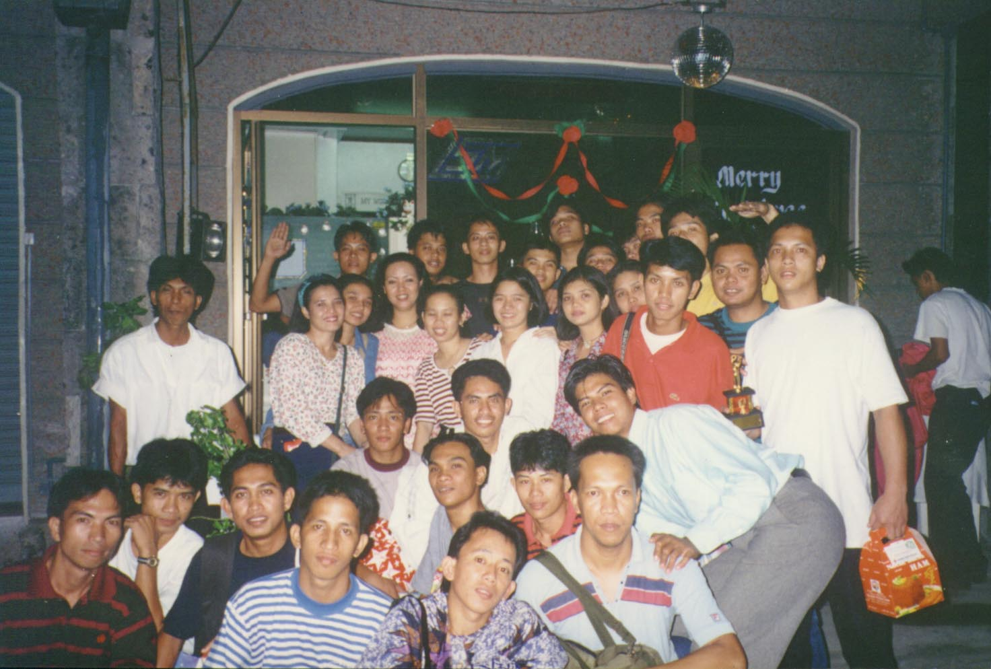
List of Clients for Testing and Staffing
International Communications Corporation
Jardine Properties, Inc.
Aliw Broadcasting Corporation
Honda Cars Quezon City
Alcon Laboratories, Inc.
Diamond Laboratories, Inc.
Sonny Mendoza Enerprises, Inc.
Hydel Food Industries

Slide 40
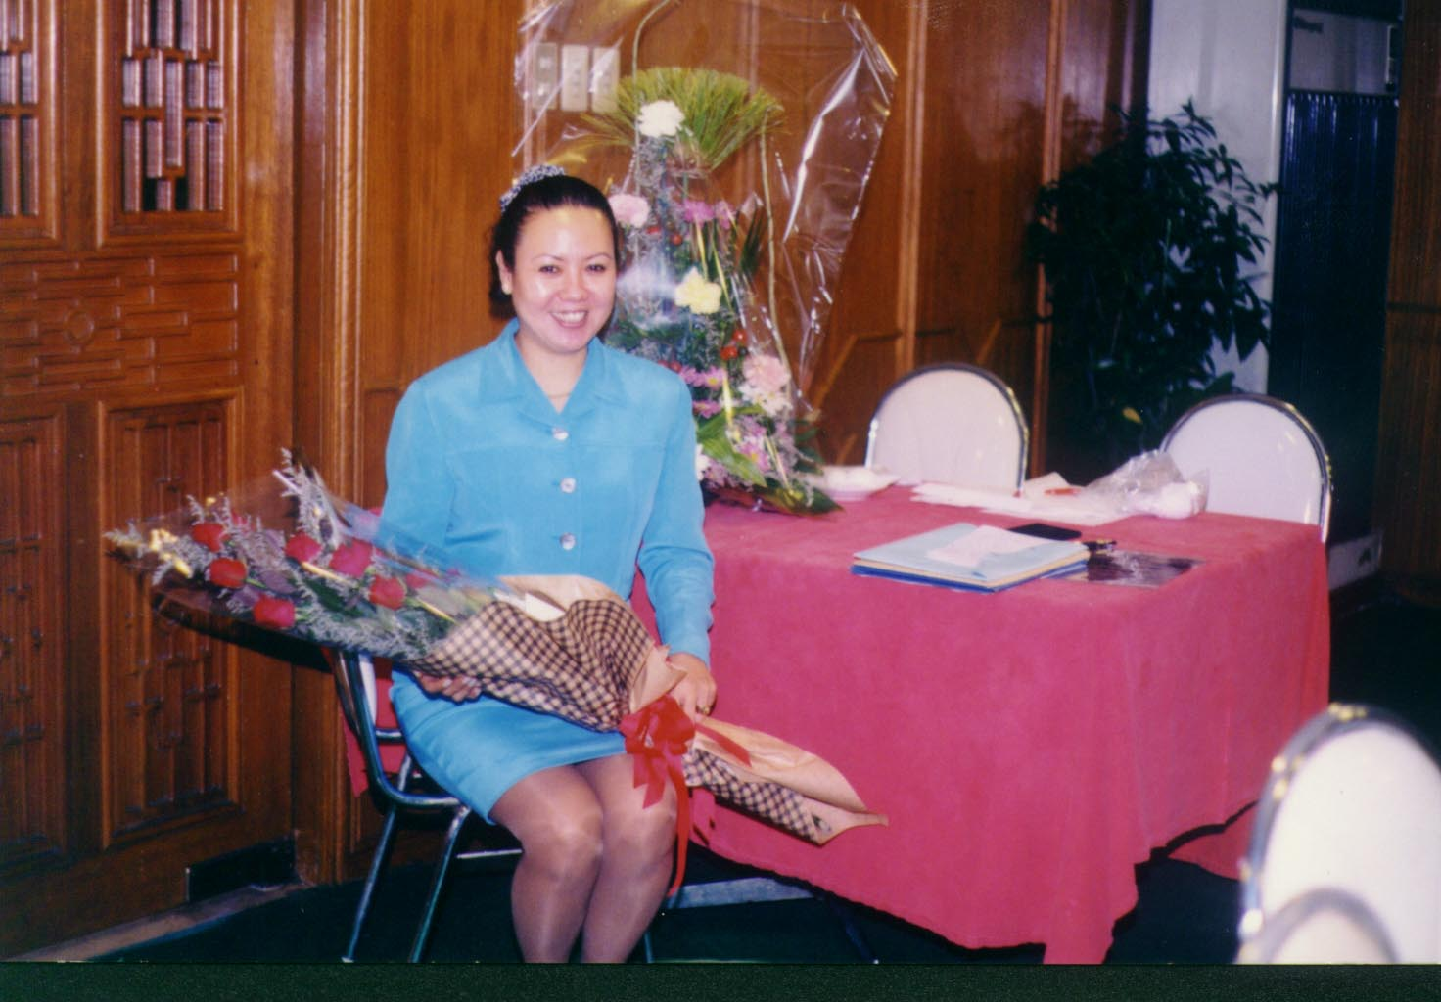
Regular Public Seminars
Ateneo de Manila Center of Continuing Studies
Ateneo de Manila - Institute of Banking
Ateneo Information Technology Institute

Slide 41
May we reach out to you from:
Lulu S. Moguel (Marketing and HRD) Consultants, Inc.
Unit 2907 Pioneer Highlands Condominium
Pioneer Street, Mandaluyong City
Telefax: 638-4048
CP: 0917-8300058

